Slide 1
Tiaki hauora

Slide 2
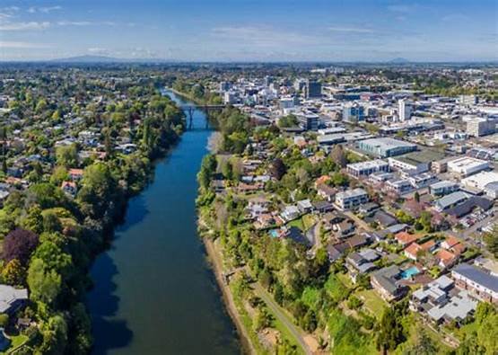
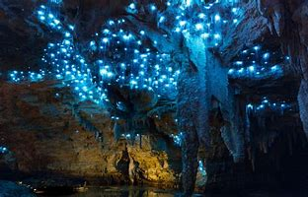
3 questions

Slide 3
#1. What’s tiaki hauora

Slide 4
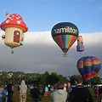
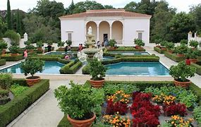
Tiaki Hauora

Slide 5
#2. What’s the difference?

Slide 6
Decolonise health
184 years
NZ’s intent
Lifetime debt
Perceptual ill
No cure
Prevent & cure
Choice
Resilient
Self responsible
Not reliant
Experts

Slide 7
#3. Hamilton vision
Hub, family centre ,retreat, sanctuary, marae

Slide 8
Transitioning
Café corner
New mothers space
Edible garden
Clinic room
Recreation
Maunga - mountain
Awa - river
Ngahere – forest

Slide 9
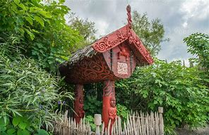
Tika, pono, aroha
River of life
Sustained & organised
Collective & fluid
Inclusive & diverse
Helping one another
Kotahitanga
Turning humanity
Health ed & function
Natural empowering
Self confidence
Whenua & whakapapa

Slide 10
Pou #1 - mana taiao Pou #2 - mana motuhake Pou #3 - mana kai Pou #4 - mana tangata

Slide 11
Mauri Ora

