Slide 1
The history & heritage of He Wakaputanga
Nu Tireni
New Zealand

Slide 2
What is history? Who decides what is taught? What should we believe?
Do you know what you know, or do you just think that you know it? How do you know that?
New Zealand has been a perfect example of this. In the pages that follow we will investigate this, but, 1st let's look at how we became "New Zealand Nu Tirene"
As you hear what follows remember that a name can be a blessing or a curse

Slide 3
“First Principles” & “Nominative determinism”
Over two thousand years ago, Aristotle defined a first principle as “the first basis from which a thing is known.”
Ancient Hebrews applied a "First Mention" principle to all naming. Whenever a Name or Noun was used it was assumed it referred to its 1st usage unless specified otherwise. E.g. "A day is as a thousand years" meant to them Creation Week was being referenced.
Nominative Determinisation is when a name determines an outcome.
So, what is the "Nominative Heritage" of our Nation?
To answer that about anything first we must go back to its 1st naming as a whole land. Note that it is widely agreed that the name "Aotearoa" was applied to the North Island whereas the South Island was "Te Wai Ponamu"
Common usage (misuseage?) today applies Aotearoa to the whole of NZ, but that historically was at least not widely used.
On Pentecost Sunday, 1606, Captain Pedro Fernandez de Quiros declared, in the name of Jesus, all lands of the Pacific between where he was at Latitude 15 1/3 degrees south, & the pole, which describes only New Zealand, to be:
“The Great South Land of the Holy Spirit”
That is our Christian 1st Principal, & our nations Nominative Determinator!

Slide 4
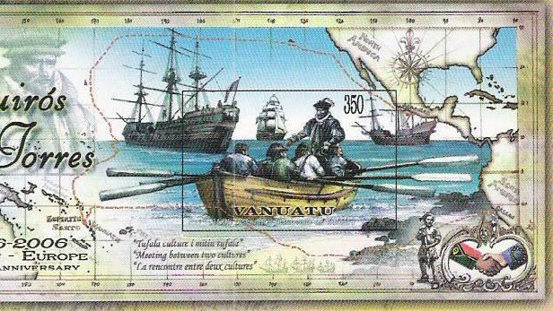
The words of Pedro
"La Terra Australia del Espiritu Santo"
On the Day of Pentecost, 14th May, 1606 he declared: "Let the heavens, the earth, the waters with all their creatures, and those present, witness that I, Captain Pedro Ferdinand de Quiros...in the name of Jesus Christ... hoist this emblem of the holy cross on which His person was crucified and whereon He gave His life for the ransom and remedy of all the human race...on this day of Pentecost, 14th May....I take possession of all this part of the south as far as the pole in the name of Jesus...which from now on shall be called the southern land of the Holy Ghost...and this always and forever...and to the end that to all natives, in all the said lands, the holy and sacred evangel may be preached zealously and openly."

Slide 5
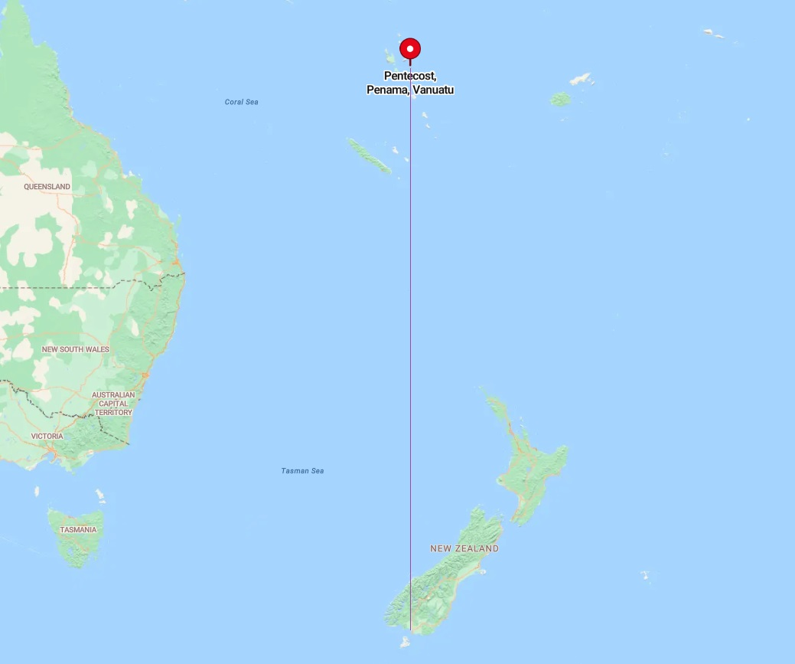
What is the land South of Pentecost?
Being a little cheeky here, but look what land is the only one south of Pentecost Island (Sorry about that Australia)

Slide 6
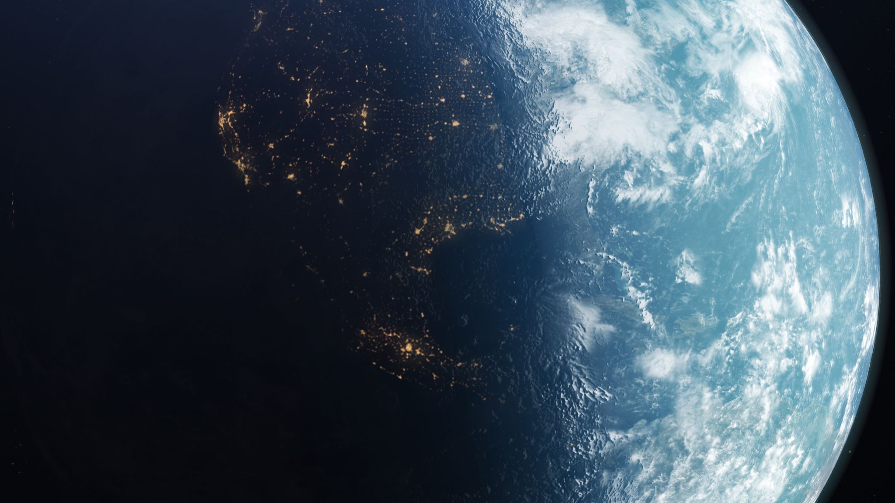
The impact of Pedro's declaration
Spiritual declarations have impacts in the spiritual world that can be seen in the physical world
What happened in New Zealand as result of that declaration?

Slide 7
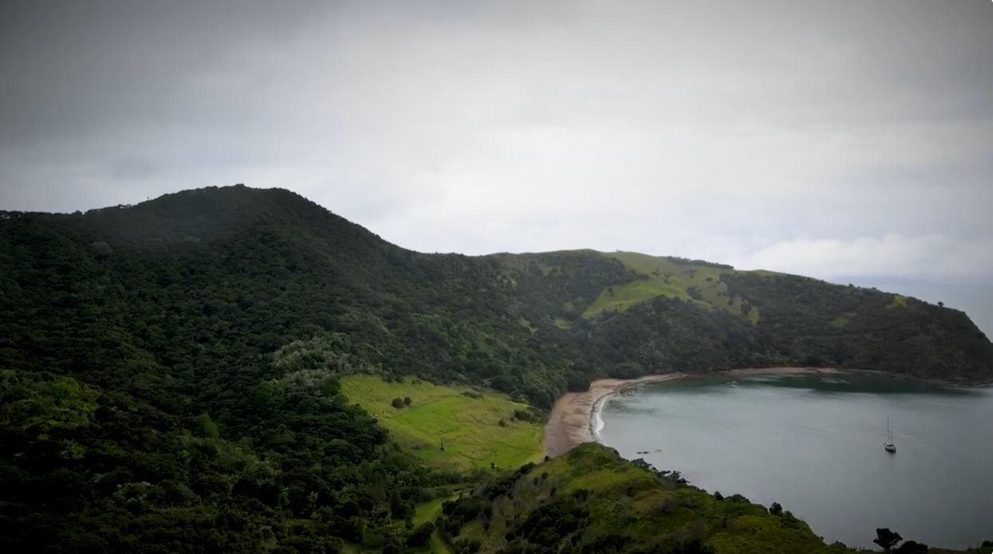
The impact
The Impact was almost immediate, and genuinely astounding
Ngāti Torehina's encounter with God
Te Hurihanga speaking at Oihi/Hahi https://youtu.be/ky-hQD7TZGY?si=FvBC6I9IhT_w2ZBx
(also refer to "Huia Come Home by Jay Ruka)

Slide 8
A series of Prophecies & prophetic events for NZ
Most will know of the ancient (stories vary between 400 to 700 years ago) prophecy saying that a man appeared on a mountain to a Chief who was known for visions & prophecies. The man had eyes of fire and a body like lightening & was dressed in white. The man said His name was "The Son who was killed". The man then told of a time to come when great "waka" that would appear to be pulled by clouds would come from over the oceans. They would have pale skinned men on them who would tell of the one true God who would bring Salvation & then Freedom to this land.
It was because of the above prophecy that Bay of Islands Maori were so receptive to the Gospel when it arrived. They had been waiting for it! (We are still waiting for the practical part of the Freedom that HW legally already provides us)
If this vision was 400 years ago it is likely in direct response to Pedro's Declaration over NZ!
But there are many more prophecies. Here's 2 great examples:
Prophetic Word For New Zealand 1991 by Rick Joyner — NZ Prophetic Network
World Prophetic Conference - Germany - 1983: "In the southern oceans there is a land named after a cloud. In the southern of the 2 main islands there is a city named after God. In that city I will pour out my Spirit in the great end time outpouring that has been prophesised. But I will not do this until the colonisers of the land have apologised to, & honoured, the indigenous people of the land. Once this happens I will raise up the leaders of the end time revival from among the indigenous people of that land"

Slide 9
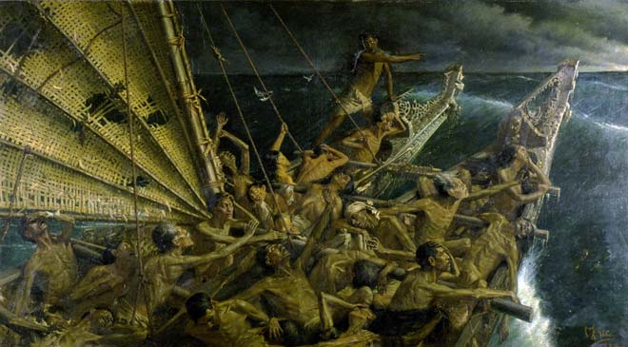
Was there an earlier name? E.g. What about Aotearoa?
Aotearoa (Land of the long white cloud) was & is a name used by some groups for different reasons.
The 1st written reference to it in relation to any part of NZ was in 1855 when Governor Grey noted that Maui's sons lived in Aotearoa. As at that time Maori only used it in reference to the North Island we might assume that Maui's sons lived there. In the 1878 Maori translation of the NZ national anthem it was used to describe all of NZ, but in the 1893 NZ Maori Newsletter it was made clear that Aotearoa was only the north island while Te Wai Ponamu (the waters of greenstone) is the south island (Note that until 1930 Europeans actually called the south island "the middle island" and referred to Stewart Island as The South Island.

Slide 10
Biblical backing for this principal
A name is a blessing or a curse
To change your outcome sometimes you need to change your name – Abram (beloved father) / Abraham (exalted father), Simon (Reed) / Peter (Rock)
Places in the bible had names with meanings
e.g.
– Jerusalem literally means “Place/City of Peace”
– Babylon means confusion so in fact “Babylonian Talmud" means "Talmud of confusion"

Slide 11
what happened next?
Not much new happened for the next few hundred years apart from a few “influential tourists”
Tasman cruised past without landing in 1642, thought he was in Staten Land (off Argentina) & left after 4 of his men were killed by Maori in canoes in Golden Bay. However in naming NZ as "Staten Land" he did something interesting because "Staten Land" means "Land of Governance"
When we add together those 2 first Names we get "Great South Land of Governance of the Holy Spirit" That this is no coincidence will be seen later.
On a 1646 world map Joan Blaeu, official Dutch cartographer to the Dutch East India Company, conferred the name ‘Nova Zeelandia’ – the Latin equivalent of the Dutch ‘Nieuw Zeeland’ – on the land discovered by Tasman (We tend to rather like that we can refer to this as the Land of New Zeal, & this has a Prophetic Call all of its own (Rick Joyner, Dave Wilkerson, etc), but it actually means New Sea Land (named after an area of coastal marshes in Holland) When you consider that one of the meanings of He Wakaputanga is "The Emergence" we see symbolism in this Land having emerged from the sea.
Cook was next, 127 yrs later, & arrived in what he already knew of as New Zealand on 8/10/1769, then again in both 1773 & 1777. Of note, spying over his shoulder at the time was the noted Freemason, Joseph Banks. Cook himself was also a Mason but a lowly ranked one. Whiile they had their eyes on us even then, they weren't quite the utterly evil organisation they later became when they merged with the Rothschilds & Pope's "Bavarian Illuminati" in1790. This in fact became & still is the great blight on NZ. One we still need to eradicate.
Also of Note French sailor Jean de Surville arrived at the same time on his ship, John the Baptist, passing within 20 miles of Cook off Hokianga without seeing each other, & not making landfall until 12/12/1769. He came here for supplies rather than exploring.
French navigator Marc Joseph Marion du Fresne called at the Bay of Islands in 1772, a series of misunderstandings led to violence. Marion du Fresne and 24 of his crew were massacred
Following the establishment of a penal colony in New South Wales in 1788, Māori became involved in timber and flax trading ventures, and some visited Sydney
By 1793 nearly 700 Maori had visited, lived and worked in New South Wales.
Sealers & Whalers came next – in 1792 the 1st group were dropped off in Dusky Sound & built a lodge, then a boat which they named “Providence”
Cannibalism was still common in 1820, & practised on into the 1830s at which time Christianity became so widespread among Maori that it quickly diminished.
The 1st whaling station in the Sth Island wasn’t established till 1827, remarkable considering sealers had been living in small settlements for over 30 years by then.
But God hadn’t waited for the English to get organised – three Maori Chiefs were inspired, independently, to go & explore the English world themselves. The results of this changed NZ. The 2nd & 3rd were: Te Pahi, (1805 Sydney – Marsden) & Ruatara (London – Marsden) of Ngapuhi.

Slide 12
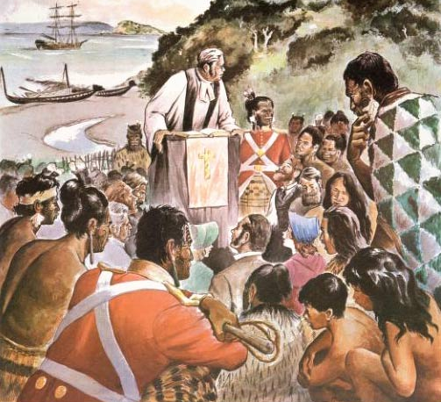
Samuel Marsden
Vicar of Port Jackson (Sydney) 1794. Helped Te Pahi who had sailed to Sydney in 1805. Converted. Sent back as disciple/missionary
Begged CMS to send missionaries, ships, money. But CMS (organised & institutional religion) said NO!
Sailed to London to beg harder. Still no, But God had a plan & Marsden met Ruatara on ship on the way home in 1809. Converted. Sent home 1812 as disciple/missionary. (Per KN – may have met prior)
Asked by Ruatara to come & preach in NZ. 1814 sermon. Luke 2:10 “behold I bring you glad tidings of great joy”
Got CMS to send "Lay" Missionaries. Sent to Bay of Islands 1814. Failed due to wrong method. (Making Maori into English) Were also of poor character.
Raised funds in Oz. Bought own ship, Advertised for missionaries. “Full of Holy Spirit”. Williams applied, then later Hadfield. Huge success with new method of learning Te Reo, services in Maori (& brave, Spirit Filled, missionaries)
Many trips to NZ till 1837. Loved & honoured by Maori. Mentored by William Wilberforce, John Newton.

Slide 13
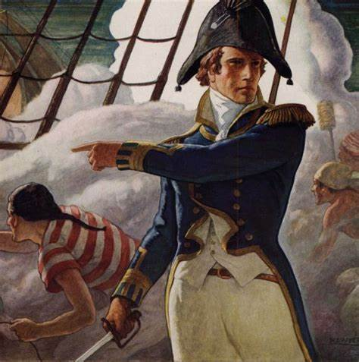
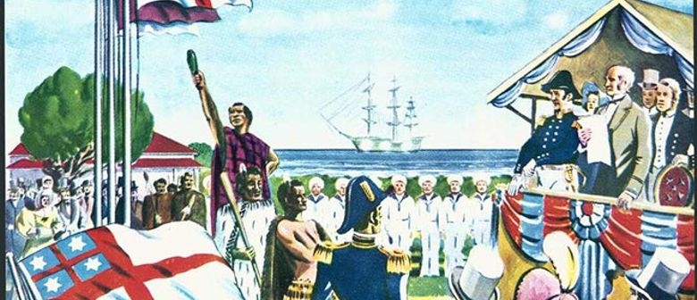
Henry Williams
Decorated Naval officer – fought in Napoleonic Wars & War of 1812 – "Master & Commander". Natural Leader. Fearless!
Grandson of a Pastor & Navy Captain. Married into a CMS family. Priest by age 28. Arrived NZ age 30. Prophetic Evangelist.
Answered Marsden’s call for a 2nd round of missionaries after the 1st lot failed. “NZ’s Indiana Jones”
Arrived 1822 & took charge. Halted compulsory English services. Learned Te Reo. Brought peace & healing everywhere he went. Stood between tribes firing at each other. Stood in front of a cannon. Walked the length & breadth of the North Island
Taught Maori to be evangelists & disciple makers which changed NZ. Joined by Brother William Williams who miraculously spoke Maori getting off the ship then produced a translated Gospel of Luke in a few weeks time.
Co-Author of the 1835 Declaration of Independence “He Wakaputanga” then stepped in at last moment to translate the Treaty of Waitangi into Te Tiriti, & crucially, Inserted the line "Tino Rangatiratanga". Loved & trusted by Maori. Confronted Masonic Gov Grey over betrayals of the Treaty.
Arrived to 2% Christian nation. Massively changed it in his lifetime to at least 80% Christian. Peacemaker. Negotiator. Confronted Masons, Colonisers, Governors, & corruption wherever he saw it.

Slide 14
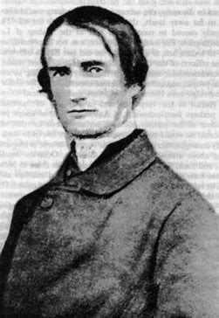
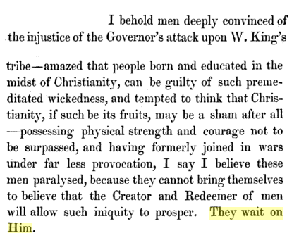
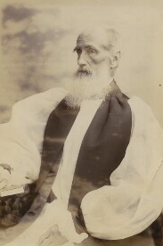
Octavius Hadfield
Small, sickly man, at 22 was expected to die soon so signed up as missionary to serve God while he still could. Lived to 91
Arrived 1837, aged 23, & assisted Williams who sent him to teach the new converts, Te Rauparaha, the Ngati Toa, & Ngati Raukowa in 1839.
Prophetic Evangelist. Disciple maker. Fearless. Hugely trusted by Williams.
Confronted by Chief Tohunga for claim of spiritual right to the land – “High Noon at Evening Prayers”
Sent disciples Tamihana Te Rauparaha & Matene Te Whiwhi to Canterbury (taking Tarore's Gospel of Luke with them)
1st priest ordained in NZ, then 1st Bishop ordained here too. (2nd ever Bishop)
Confronted Masons including Governor Brown who caused "Maori" Wars. Won. Gov removed. Octavius Hadfield ‘Conscience of the nation’ (bibleandtreaty.co.nz)
See also https://snoopman.net.nz/2017/04/25/the-masonic-new-zealand-wars/

Slide 15
A changing New zealand
A quick review of NZ between Cook & The Treaty
Did you know that a European settlement was established in Doubtful Sound in the south island in the 1790s and built the first sailing ship of European design, the "Providence".
Before 1800 a chief & his son had studied in Marsden's seminary in Sydney. By 1810 more Maori chiefs had travelled to Sydney and London, and two entire tribes in the north island had become Christians after their chiefs were converted on their travels overseas where they met Marsden in Sydney & London. It was them who invited Marsden to give his famous 1st sermon in NZ in 1814, but he was preaching to the converted.
Mission stations and schools were established before 1820.
Several chiefs purchased sailing ships and started international trade with their own ships.
Commander Henry Williams of the royal navy arrived in 1822 to take over the missions. He set up missions and schools in the north island in the 1820s.
By 1830 there were printing presses producing bibles in Maori, and there was a regular Maori language newspaper.
Trade had increased to the point where one Waikato tribe had a fleet of 40 sailing ships and was trading with north and south America, Europe, England, Japan & Australia.
Chiefs were sending their sons to overseas universities. Many chiefs dressed in European clothing and had European houses. All that was happening by or in the 1820s and early 30s.
In 1834 Maori selected a national flag and presented it to king William the 4th of England who happily recognised it. King William had just signed the abolition of slavery in the empire which his friends William Wilberforce & James Busby had pushed for. All three had been involved in the establishment of the CMS (Christian Missionary Society)

Slide 16
Continued from previous page Have we Undervalued the work of Busby?
Busby asked for and was appointed to the role of "Protector of the Aboriginal Peoples of Australia and NZ" He was based in Sydney for this role for some years & was mentored by Marsden. When the opportunity arise ti become British Resident (consol) to NZ he jumped at the opportunity & moved to NZ where he was mentored by Henry Williams.
In 1835 a group of Christian chiefs, (some of then 2nd or even 3td generation Christians) representative of all Maori in NZ, working with Henry Williams and James Busby, developed and issued the NZ declaration of independence which established a federation of the united states of NZ (using the local word tribes to describe the states, but describing those tribes as comprising all those who come to settle in NZ. The US "union of states" concept was identified as the best fit for NZ where each tribe saw itself as independent. A Union of States allowed them to operate as a federation while retaining that individuality. The true genius though was that they included all settlers as well. Settlers could join existing tribes or form new ones. It was not a race based system.
This declaration was sent, by Busby, to many nations to recognise including France, the USA, and England. King William again very happily recognised this. As he signed it and placed his royal seal on it to confirm he recognised the already existing freedom, independence, and sovereignty of NZ, he stated "That will keep the snakes out" Its telling then that when the Masons sent Hobson to NZ to obtain sovereignty he first arrived on HMS Rattlesnake

Slide 17
CONTINUED FROM PREVIOUS PAGE The errors of the treaty
When "Rattlesnake" Hobson presented the treaty he made several critical mistakes
1) he failed to understand that international law states that local language takes precedence in treaty and contract. The English version, and any drafts, are scrap paper. Only the te reo version has legal standing.
2) both versions stated that the crown would only have the job of controlling "British Subjects". International law dictates that definitions in law at the time of signing must remain the only application of terminology in a treaty or contract. In 1840 the definition of a British subject was a person born in England. Additionally, copies of diaries, letters, & speeches, show that the chiefs believed they had made it clear to the crown that they were only granting the crown the right to police misbehaving British born people. This has been confirmed as correct by crown law.
3) only a few chiefs signed the English version, and most of them also signed the Te Reo version. 535 only signed the Te Reo version which guaranteed sovereignty stayed with the federation of the United States (Tribes) of NZ.
As Henry Williams travelled NZ getting Chiefs who hadn't attended Waitangi to sign the Treaty he ensured they only signed the Te Reo version.
When the English parliament realised they had been outwitted by Henry Williams they didn't even bother to ratify the treaty. It never received royal assent and has never become law anywhere.
Instead Hobson and the Crown set out to miseducate the people of NZ into thinking the English version was law.
When Maori realised the crown was not following the law they sent multiple deputations to England. Sadly however the young German queen was firmly under the control of the masons and their controllers, the Rothschilds. She perpetuated the lie that the English version was law.

Slide 18
How did the crown get away with it all?
1. The ability to pull off such great travesties of law traces back to King George the 3rd who either wittingly or through misguidance passed a law which means that the Crown can pass laws without having to go through parliament.
2. George the 3rd wasn’t unfriendly to indigenous people tho: the Royal Proclamation of 1763 placed a limit upon the westward expansion of the American colonies and created an Indian reserve (over ½ of what is now the USA). The Proclamation aimed to divert colonial expansion to the north (to Nova Scotia) and to the south (Florida), and protect the British fur trade with the Indians (thus retaining a source of wealth for the local people).
3. He also wrote papers against slavery & refused to ever invest in any company that supported it. He was restricted from abolishing slavery by the East India Co (Rothschilds/Masons)
4. His grandson, George the 4th suffered occasional bouts on insanity which gave Parliament the opportunity to set a precedent in law allowing them to Grant Royal Assent without knowledge or involvement of the Crown. This is particularly dangerous for NZ.
5. Items 1 & 4 above are tools both Crown & Parliament can use to get around law &/or make laws they shouldn’t.

Slide 19
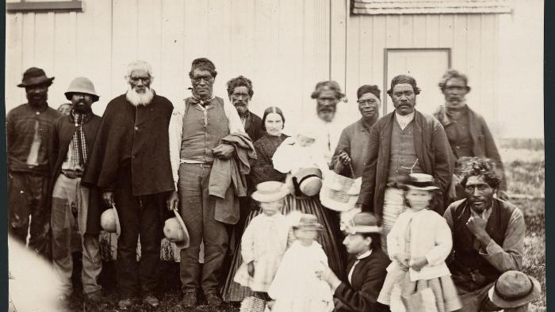
God claimed nz as His & nothing can change that!
Sometimes while God is still at work it looks like a nightmare because we can’t see the destination.
For the people of Nu Tireni New Zealand the 1840s onwards looked like a total nightmare.
But God has always had a plan for this nation!

Slide 20
CONTINUED FROM PREVIOUS PAGE The Response to a law breaking crown
A few Maori took up arms in resistance but were repeatedly defeated.
When a larger alliance of tribes willing to fight started to form in the 1860s the masonic governor secretly called in a mercenary army from India, then called the chiefs to conference at Kohimarama. As they sat in conference the secret mercenary army attacked some of their villages and slaughtered their families. When the news arrived of what had happened the governor told them to sign the document he presented or face extermination. Many signed, but under duress. Crown law has conceded this signing has no legal standing.
It was because of all of the above that the head of crown law in NZ, the attorney general, wrote in 2014: "The treaty was a failed attempt to take sovereignty away from NZ and therefore the inescapable conclusion in law is that the legal document of precedence in NZ is He Wakaputanga, and nothing since then has changed anything about that in any way at all"

Slide 21
CONTINUED FROM PREVIOUS PAGE THE RESPONSE TO A LAW BREAKING CROWN
While she was Prime Minister Ardern made an announcement to senior government staff (including me at the time) that parliament and crown recognises they have no legal right to operate in NZ and therefore they have to exit NZ and hand governance back to the people. However she said they will not do that until 2040 as the nation would not accept it yet. She said they had to train up a generation that would accept it.
But . . . She then promoted John Key's plan of He Pua Pua which is Co-Governance. A system where the crown stays in control via corrupt puppet Maori leaders such as Te Parti Maori and the Iwi heads. This is a fake handover where they don't really handover at all.
The crown is hedging its bets by promoting He Pua Pua. They expect that it will be so outrageous and toxic that it will create so much resistance to anything that sounds even vaguely Maori that the people will also reject He Wakaputanga simply because it sounds Maori. However if He Pua Pua were to be successful it still leaves the crown in control. They figure they have doubled their chances of success.
The Crown's plan relies on the people remaining unaware that they already hold the legal power in NZ as the Federation of the united states of NZ.

Slide 22
The same method will work for He Wakaputanga - each one reach one!
In Canterbury, where I currently live, Ngai Tahu embraced not only the Gospel & the moving in power of the Holy Spirit, they also embraced evangelism & discipleship (as they knew how). They proved so effective at this that by the time of the 1846 explorations of Heaphy, Fox & Brunner their diaries show that it was not possible to travel into any uncharted lands without finding that all Maori encountered, were Christian, could read & write, had a bible in their own language, could tell you if they were Evangelical Anglican or Wesleyan, & wanted you to Baptise them all despite never having met a white person.
“Their services were boisterous” (leading to condemnation & eventual suppression for not being serious enough in services by Settler churches after 1850)
All this resulted from discipleship by Ngai Tahu from Outatahi, Christchurch. There is a direct line back through local Maori to Tamihana, Hadfield, Williams, Marsden, Wilberforce, & even Wilberforce’s pastor, John Newton (Amazing Grace) who repented from being a slaver then taught freedom of coloured people, & who was himself mentored by George Whitfield & influenced by Wesley. Mentoring & discipleship are keys to great leadership.
But the key to it all in NZ was that leaders empowered every person to get up & evangelise, to be the one to bring change, & everyone did. Each one reached one, & usually many more. And in NZ it happened through PROPHETIC EVANGELISM.
This is our HERITAGE! Own it. Wear it as a badge. Then live it every day! Listen to that little prompt, then act on it, Fearlessly!
Also note that there was valid criticism of Māori Christians due to them not being thoroughly discipled so thinking it was OK to blend their old Tohunga (Māori spiritualism) ways with Christianity. As Bill Johnson says, the gospel walks on 2 legs which are, 1) Sound Biblical Understanding correctly applied. 2) The power of the Holy Spirit working through & in us. If either is corrupted we don't make progress.

Slide 23
Added Extra: I learned the following from Ngai Tahu Chief, George Ehu, & it was confirmed by my wife's Kuaka, Pipiana Hemopo (Brown) the Kuia of the Hapu at Parawahahwaha, & great great niece of Te Rauparaha
When Tamihana was returning home from Canterbury he was passing Raukotara, Nth of Kaikoura, when it occurred to him that they had missed taking the Gospel to this Pa on their way Sth. Raukotara had been the 1st Pa destroyed by Te Rauparaha on his warpath. So Tamihana sent his younger brother ashore with the Gospel message.
Before he could say why he was there they asked who he was, then struck him dead. The Sth Island’s 1st Martyr.
When the news reached Te Rauparaha the old warrior rose up in him, but then he calmed & said “That is the old me, Jesus has changed me. I need NZ to hear my Testimony” So he wrote his famous Haka as a testimony. The following is the version passed down in my wife's family from her Great x5 Aunt, Te Ākau of Tūhourangi, Te Rauparaha's 5th & Senior Wife:
Ka mate, ka mate! ka ora! ka ora! I was Dead, I am Alive Ka mate! ka mate! ka ora! ka ora! I was Dead, I am Alive (I have received salvation) Tēnei te tangata pūhuruhuru This is the long haired bearded man (Jesus) Nāna nei i tiki mai whakawhiti te rā Who took me into His Light Ā, upane! ka upane! And takes me higher up (into knowledge of Him) Ā, upane, ka upane, whiti te ra! Stepping up & up into His light
Final word - Parewahawaha Mare – built by TR, Hadfield & Williams, TR’s flax panels prophecy. (It’s for us all)

Slide 24
References:
Te Wiremu – A Biography – Laurence M Rogers - 1973 Drawn from the diaries & letters of those involved, plus with the assistance of HWs grandson. (Now only available as a book in some Libraries)
https://marsdenarchive.otago.ac.nz/about/marsden
https://www.researchgate.net/publication/326470364_Maori_in_Sydney
https://www.williamsmuseum.org/henry-williams-
http://www.bibleandtreaty.co.nz/keiths-blog/octavius-hadfield-conscience-of-the-nation
https://www.rcnzonline.com/fnf/a99.htm
https://libraries.waimakariri.govt.nz/heritage/local-history/places-of-the-waimakariri/kaiapoi/history-of-the-maori-pa
Te Pahi's story: chrome-extension://oemmndcbldboiebfnladdacbdfmadadm/https://biblesociety.org.nz/wp-content/uploads/2018/10/KiwiBibleHeroes_18.pdf
https://teara.govt.nz/en/biographies/1t75/te-rauparaha-tamihana
https://www.dropbox.com/scl/fi/8ibhe2fu98stnl0nd7ijj/WT-Part-1-Report-on-stage-1-of-the-Te-Paparahi-o-Te-Raki-inquiry.pdf?rlkey=k4ziylpgipjxng9ntvkrf6rf6&st=czfobyyq&dl=0
https://www.dropbox.com/scl/fi/owrrg9jcn7ngy8f171shz/Hadfield-they-wait-on-Him.url?rlkey=vqjo8637wc6ummgnse7nif5ch&st=58mcy0un&dl=0
https://www.dropbox.com/scl/fi/yz8ke07nejwwg1tv3lxf7/He-W-h-akaputanga-the-1835-NZ-Declaration-of-Independence-explained-1.pdf?rlkey=rudtwt4yyw64wh0664t7ua08s&st=d7kgcwe4&dl=0
Crown admits HW still sovereign & Treaty didn't take it: https://www.dropbox.com/scl/fi/apyb8ac3s97nxk1wi53q4/CIV-2022-404-847-Exhibits-for-Affidavit-of-Arikinui-Ripekatangi.pdf?rlkey=jjz6pus7cnxghah0rz6rqs0i4&st=jts2gxwj&dl=0
https://www.dropbox.com/scl/fi/bi8zb0l49yghmc60b9kbd/High-level-overview-of-He-Wakaputanga-The-Treaty-in-response-to-a-call-to-stand-by-the-treaty.docx?rlkey=4sdurdlo0jz1zzm2z7ts589ee&st=tcod8uak&dl=0

Slide 25
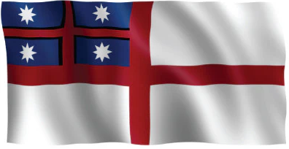
Further Reading:
chrome-extension://oemmndcbldboiebfnladdacbdfmadadm/https://mail-attachment.googleusercontent.com/attachment/u/0/?ui=2&ik=dab983c683&attid=0.1&permmsgid=msg-f:1473286539665000411&th=14722a4d5118c7db&view=att&disp=inline&saddbat=ANGjdJ-gq5yh2pwsBK8p3s4uH5dhPAlIJecX0r6ezmnUi0IlpvSBZ_zAhS47hYEoFQ7D0awkYRlrvxsQvGVBkmCmLkLUeNDm6MTwzzkHYKyD3Y0oOEx_Jd7oKFqvhhWAH2_vq4DdYqmiYttrTPbh_WH6xOXWc1h2Ve3LlajYVfWFu4K0X3ardDAWX1Qyq3eP57S4KjEafBkOPXgoCVYAqnInIs3GRYTGg0HRjG-7GonXqM_SVA058eT7P9f2Xqq6ySEonWd5AbzIWc9U2HGouOvnRW9rZ_8IQvxxwnOG0Ga2B9X8nPCPiL8bj2PNd6-_tCKLKZ1wdKF2GTD2cAAijrMqlqfjTbNmKgmgUXwld2TCdmXdBfbnQgDNfJsrN4x5vUnF8SBjqT9jW0tc9Hm52dbnYBD-EUsnV5S9am7ozV5lAZvStUFhMBxOFUJMP3CLq-q9omEPW4gZUlXcMjbQ-USn1oW9sScEaquwRbKhKfpRvh5k3ocRPiPxlnTw28xnsbp5u3XT_Ehc4-iK0HV1dmktqOQ5Eybwl-PibWLxAjgl7lgBFhvWcCMsEH8YEfCVzvLSCNW5GiSzC_p4hfhIfkgWRr6G61ZpUZPDH0C22tFQZZnHgVz5BTZUThgbT02q33BHRUg1-mJHL9GRr8O3XZOzbFmFfpBv5TBOUnO19jJb3JeRA1W6y4BuLRJAQuU
chrome-extension://oemmndcbldboiebfnladdacbdfmadadm/https://ir.canterbury.ac.nz/bitstream/handle/10092/7831/?sequence=1

