Slide 1
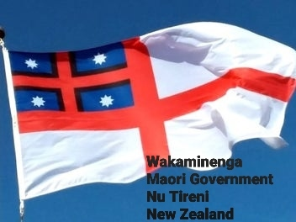
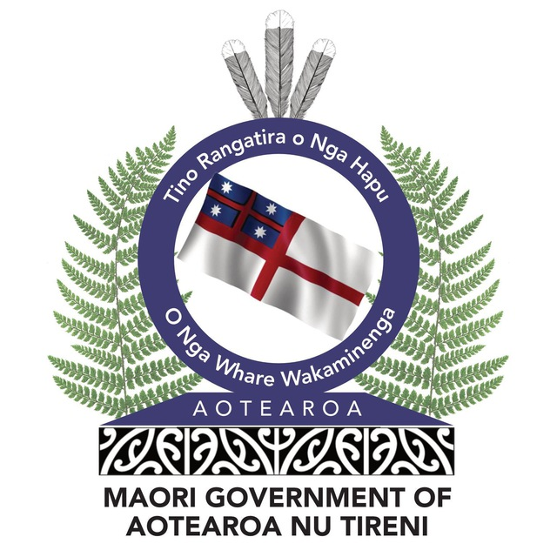
Wakaminenga National Congress 13 July 2024 Leaders’ Summit

Slide 2
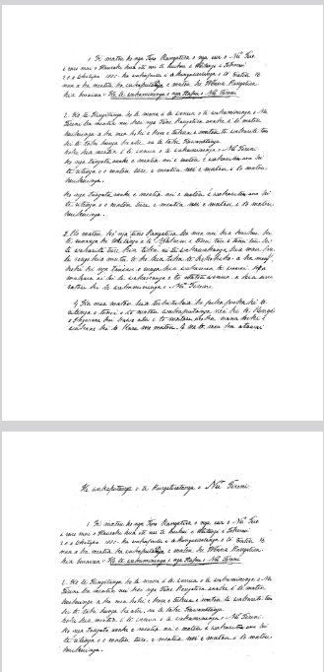
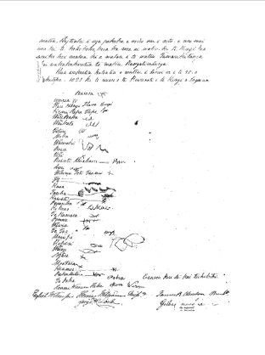
HE WHAKAPUTANGA 1835 CONSTITUTIONAL FIRST NATION LAW Unextinguished Supreme Law of Nu Tireni New Zealand

Slide 3
POWERS AND AUTHORITY
UNITY
JUSTICE
PEACE and GOOD ORDER
GOVERNANCE
PROTECTION
FREEDOM
PROSPERITY
Article 2 of He Wakaputanga 1835 holds that sovereign power and authority in New Zealand is “...declared to reside entirely and exclusively in the
hereditary chiefs and heads of tribes in their collective capacity who also declare that they will not permit any legislative authority separate from themselves in their collective capacity to exist, nor any function of government to be exercised within the said territories, unless by persons appointed by them, and acting under the authority of laws regularly enacted by them in Congress assembled.

Slide 4
To Claim to be a Sovereign Nation You Need a Coherent Body
https://www.youtube.com/watch?v=EWhfCKGGi7E

Slide 5
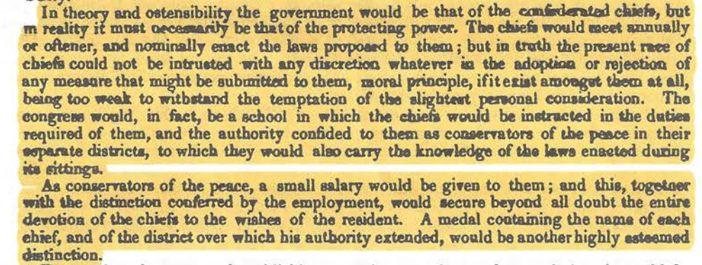

Slide 6
Busby was not in favour of it because he believed that the chiefs did not have the competence to agree for a treaty, the real purpose of it as we know now was not disclosed.

Slide 7
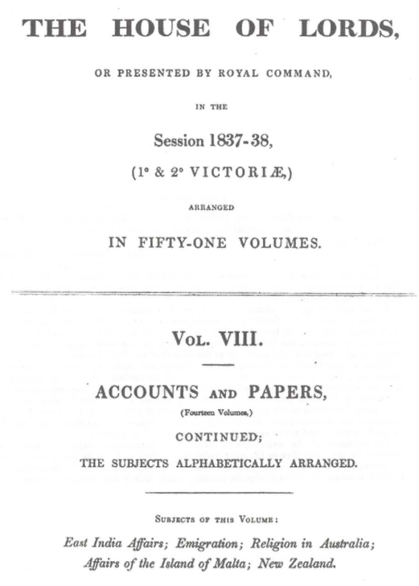

Slide 8
The NZ govt attorney general wrote in 2014, after the decision of Te Raki wai 1040 that the chiefs did not cede sovereignty … "the treaty was a failed attempt to take sovereignty away from New Zealand and therefore the inescapable conclusion in law is that the legal document of precedence in New Zealand is He Wakaputanga and nothing since then has changed anything about that.

Slide 10
The Confederation protects the individual and collective sovereignty of all people in NZ.
Te Wakaminenga Congress of the Confederation has now reformed and invites all NZrs, Maori, Pakeha and immigrants ( tauiwi), " to consult the safety and welfare of our common country by joining the Confederation of the United Tribes...“
article 3 He Wakaputanga

Slide 11
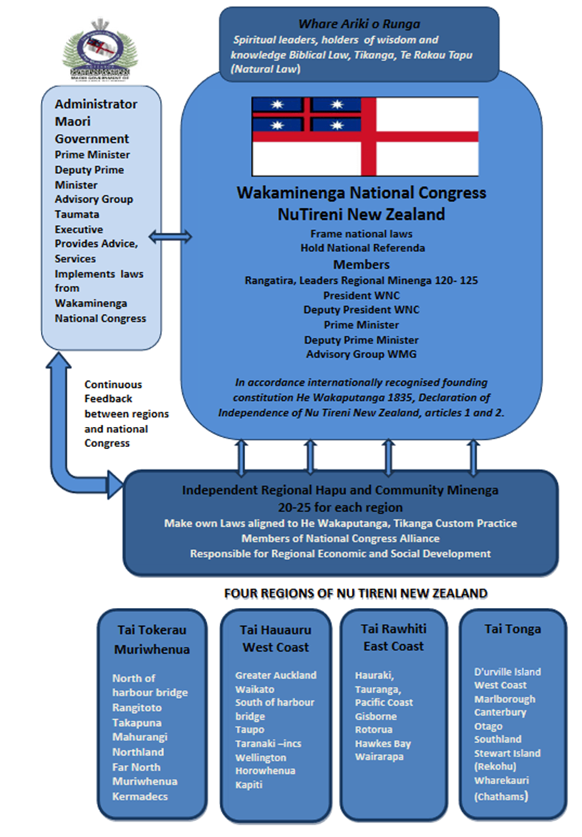

Slide 12
Globalist (UN, WHO, WEF) agenda of 2030 to take over the national sovereignty of all nations. A dystopia expressed as “ You will own nothing and be happy”…

Slide 13
Global Reset of Sovereign Nations
WEF, WHO, UN
Stakeholder Capitalism – Corporate Shareholders.
Corporations control environment, social interaction and governments
2030 ,” you will own nothing and be happy” a complete dystopia
https://yellow.forum/t/stakeholder-communism-documentary-director-richard-jeffs/44?fbclid=IwZXh0bgNhZW0CMTEAAR02V1p_VKz9gW-8y8vUZpd6rp7l403e34u0N4h7G9JWZX7wSd0-dXYggTk_aem_1DmWHJK79ErAqXzR0X69pw

Slide 14
There is only one sovereign, the Collective Confederation rangatira and leaders of the United Tribes of Nu Tireni, known today as the Wakaminenga National Congress. The Congress invites all NZrs to consult the safety and welfare of our common country by joining the Confederation of the United Tribes …. Article 3 He Wakaputanga 1835.

